Slide 1
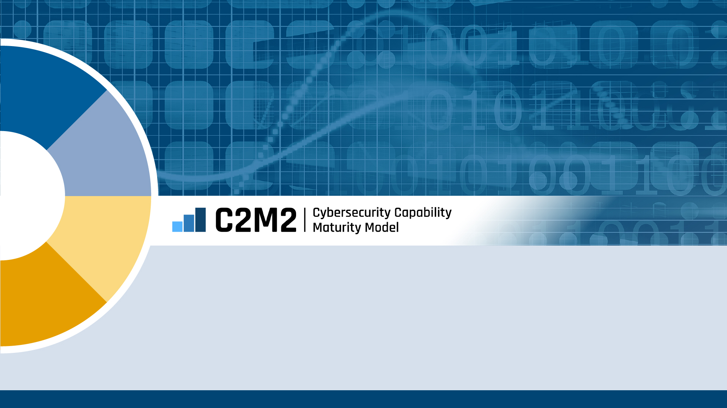
Cybersecurity Capability Maturity Model (C2M2) Version 2.1
Overview

Slide 2
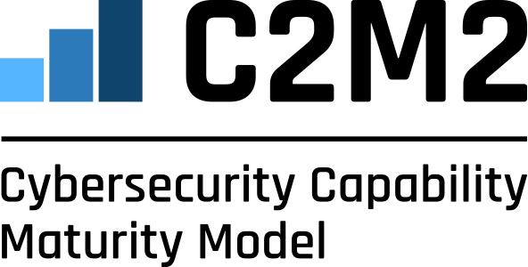
C2M2 Version 2.1 Overview
The C2M2 is a free tool to help organizations evaluate their cybersecurity capabilities and optimize their security investments.
Designed for any organization regardless of ownership, structure, size, or industry
Uses a set of 350+ industry-vetted cybersecurity practices focused on both information technology (IT) and operations technology (OT) assets and environments
Results help users prioritize cybersecurity investment decisions based on their risk
Developed in 2012 and maintained through an extensive public-private partnership between the U.S. Department of Energy’s Office of Cybersecurity, Energy Security, and Emergency Response and numerous government, industry, and academic organizations
Recent updates in 2022 reflect new technologies, threats, and practices

Slide 3
Benefits of Using the C2M2
Planning | Evaluating
Maturity model structure facilitates cybersecurity program planning and target-setting | Enables consistent evaluation of cybersecurity capabilities and tracking of progress over time
Prioritizing | Reporting
Helps companies prioritize actions and investments for cybersecurity improvements | C2M2 assessment tools produce views of cybersecurity program status that can be used in reporting

Slide 4
Key Features of the C2M2
Area | Description
Maturity Model | The C2M2 consists of cybersecurity practices that are organized into three progressive levels of cybersecurity maturity.
Management Activities | Management activities measure the extent to which cybersecurity is ingrained in an organization’s culture.
Specificity | The C2M2 is descriptive, not prescriptive. Practice statements focus on outcomes that may be implemented through any number of measures.
Scoping | The C2M2 may be applied to an entire enterprise or to individual parts of the enterprise to enable users to select an appropriate level of granularity.
Usability | A C2M2 self-evaluation can be completed in one-day using a free tool that securely records results and generates a detailed, graphical report.

Slide 5
What is a Maturity Model?
A Crawl/Walk/Run-style set of characteristics, practices, or processes that represent the progression of capabilities in a particular discipline.
A tool to benchmark current capabilities and identify goals and priorities for improvement.

Slide 6
Model Organized by 10 Domains
Asset, Change, and Configuration Management
Threat and Vulnerability Management
Risk Management
Identity and Access Management
ASSET
THREAT
RISK
ACCESS
WORKFORCE
RESPONSE
Workforce Management
Event and Incident Response, Continuity of Operations
THIRD-PARTIES
SITUATION
Third-Party Risk Management
Situational Awareness
PROGRAM
Domains are logical groupings of cybersecurity practices
Each domain has a short name for ease of reference
ARCHITECTURE
Cybersecurity Program Management
Cybersecurity Architecture

Slide 7
Model Structure
Model
Domain
Model contains 10 domains
Approach Objectives
Multiple approach objectives in each domain Unique to each domain
Practices at MIL1
Approach objectives are supported by a progression of practices that are unique to the domain
Practices at MIL2
Practices at MIL3
Management Objectives
One per domain Similar in each domain
Practices at MIL2
Each management objective is supported by a progression of practices that are similar in each domain and describe institutionalization activities
Practices at MIL3

Slide 8
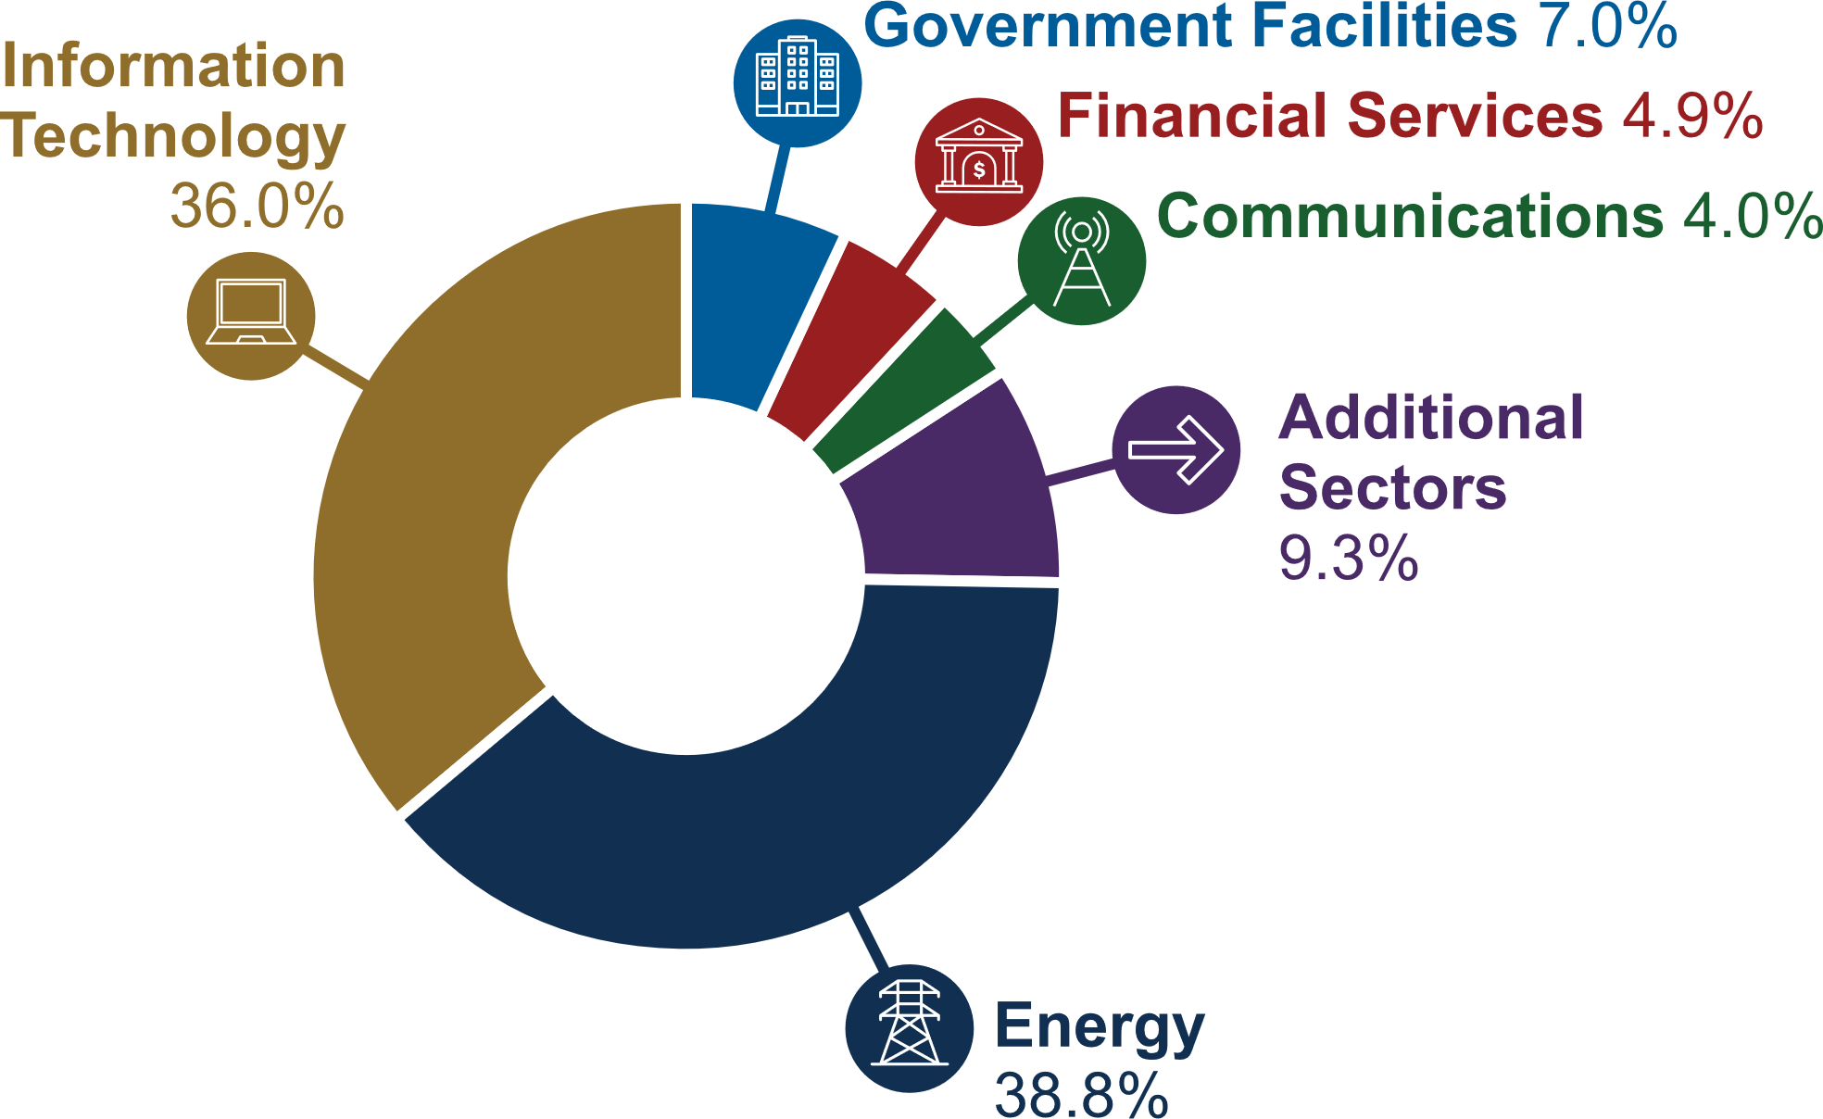
C2M2 Adoption by Sector
Since 2012, DOE has responded to more than 2,400 requests for the C2M2 PDF-Based Self-Evaluation Tool from owners and operators in U.S. critical infrastructure sectors and from international partners.
C2M2 Tool Requests By U.S. Sector
Data current as of March 2023

Slide 9
C2M2 Version 2.1 Resources
Visit energy.gov/c2m2, c2m2.doe.gov, or email C2M2@hq.doe.gov for more information.
Model Document | Introduces the model practices, key concepts, and how to use the model
Self-Evaluation Tools | The tool, available on two platforms, offers interactive features and help text, allows users to securely record results, and automatically generates a detailed, graphical report
Self-Evaluation Guide | Guides users to plan and facilitate a self-evaluation workshop with key participants in their organization
Self-Evaluation Workshop Kickoff Presentation | Supports planning for a self-evaluation workshop
Self-Evaluation Cheat Sheet | Offers a placemat-style reference guide for participants during a self-evaluation

Slide 10
Thank You

