Slide 1
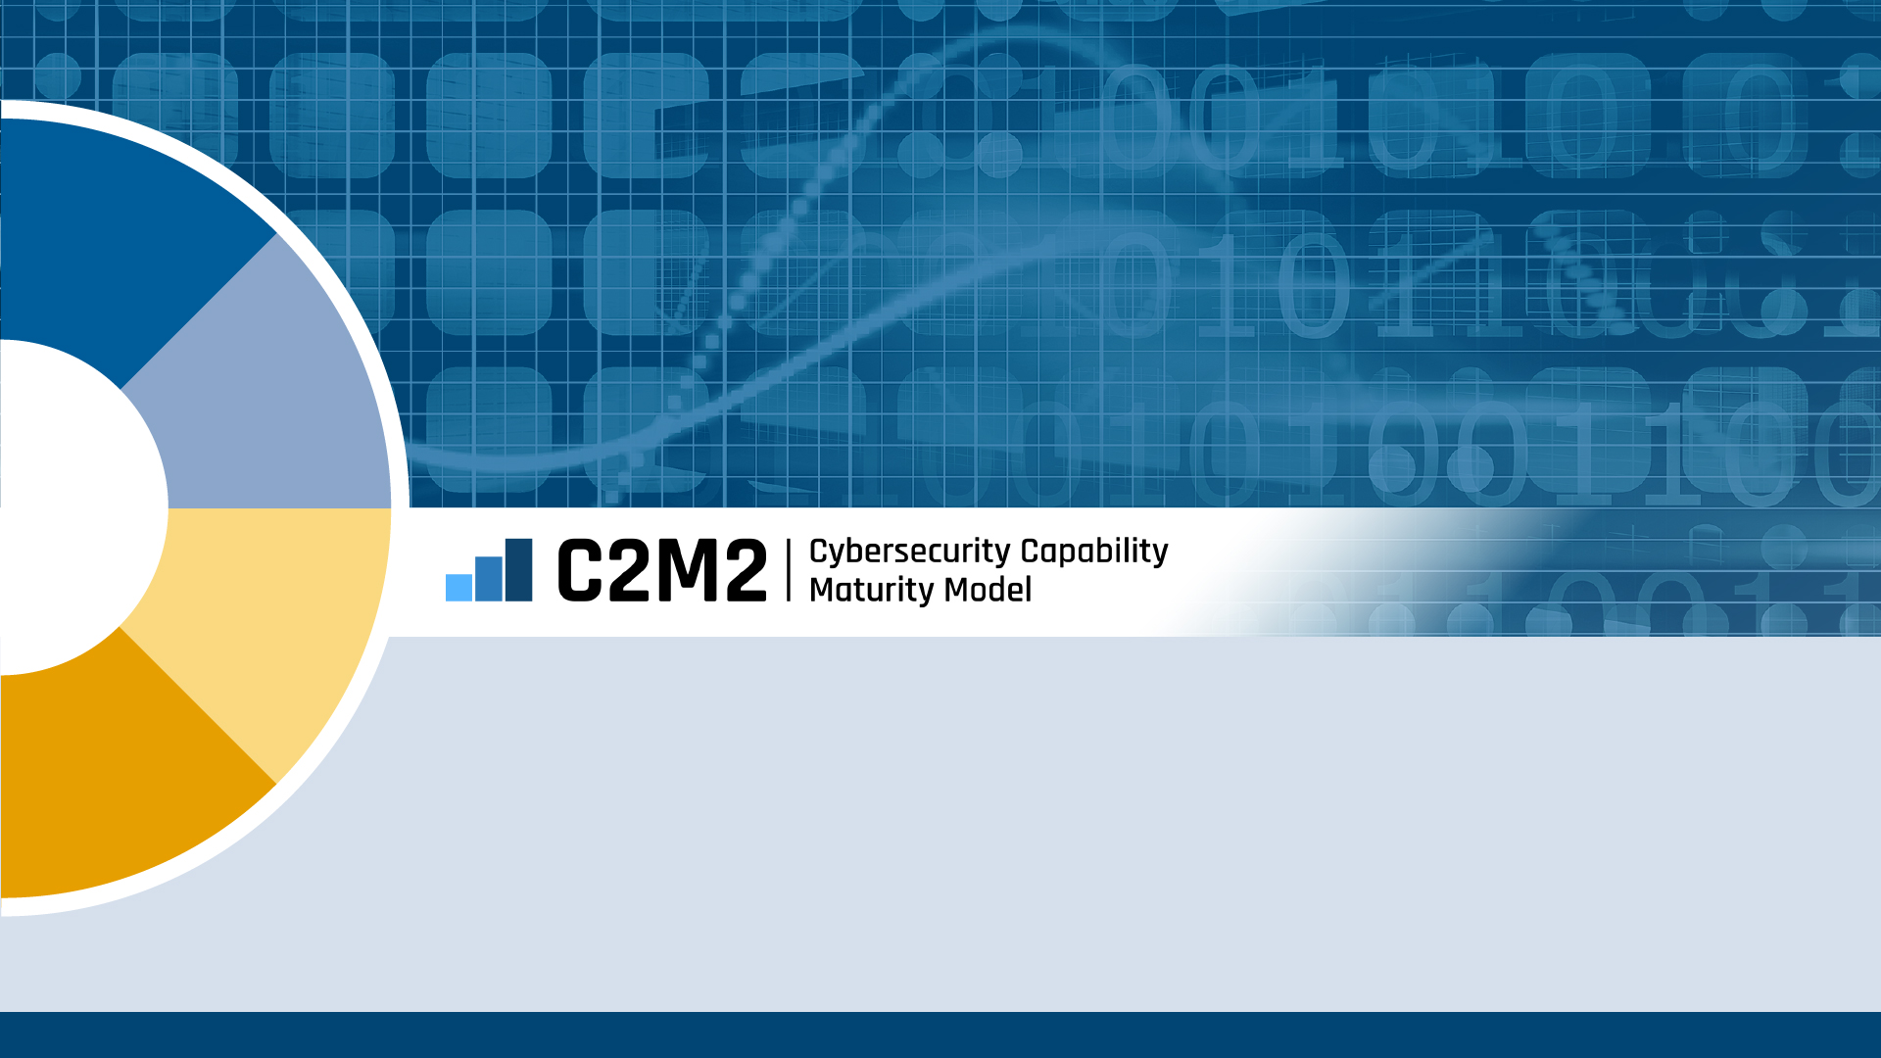
Self-Evaluation Workshop Kickoff
Organization Name

Slide 2
Agenda
1. | Opening Remarks
2. | C2M2 Overview
3. | Self-Evaluation Overview
4. | Scoring and Interpretation
5. | Questions

Slide 3
Facilitator Opening Remarks
Facilitator Name, Title, Organizational Business Unit
Notes:
Placeholder discussion topics
Sets the expectation for the workshop
Roles of the participants

Slide 4
Sponsor Opening Remarks
Sponsor Name, Title, Organizational Business Unit
Notes:
Placeholder discussion topics
Emphasis the importance of the effort and accuracy of responses
Discuss how the results will be used within the organization’s overall cybersecurity program
Note that next steps will be based on the organization’s risks and maturity
Highlight that the output of the C2M2 self-evaluation should drive risk conversations and allow organizations to plan periodic reviews of their cybersecurity program to track progress and validate goals.
Point out the roles of participants in follow-up activities.

Slide 5
Cybersecurity Capability Maturity Model (C2M2) Overview

Slide 6
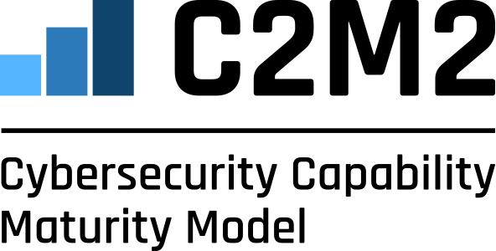
C2M2 Version 2.1 Overview
The C2M2 is a free tool to help organizations evaluate their cybersecurity capabilities and optimize their security investments.
Designed for any organization regardless of ownership, structure, size, or industry
Uses a set of 350+ industry-vetted cybersecurity practices focused on both information technology (IT) and operations technology (OT) assets and environments
Results help users prioritize cybersecurity investment decisions based on their risk
Developed in 2012 and maintained through an extensive public-private partnership between the U.S. Department of Energy’s Office of Cybersecurity, Energy Security, and Emergency Response and numerous government, industry, and academic organizations
Recent updates in 2022 reflect new technologies, threats, and practices

Slide 7
Key Features of the C2M2
Area | Description
Maturity Model | The C2M2 consists of cybersecurity practices that are organized into three progressive levels of cybersecurity maturity.
Management Activities | Management activities measure the extent to which cybersecurity is ingrained in an organization’s culture.
Specificity | The C2M2 is descriptive, not prescriptive. Practice statements focus on outcomes that may be implemented through any number of measures.
Scoping | The C2M2 may be applied to an entire enterprise or to individual parts of the enterprise to enable users to select an appropriate level of granularity.
Usability | A C2M2 self-evaluation can be completed in one-day using a free tool that securely records results and generates a detailed, graphical report.

Slide 8
Model Organized by 10 Domains
Asset, Change, and Configuration Management
Threat and Vulnerability Management
Risk Management
Identity and Access Management
ASSET
THREAT
RISK
ACCESS
WORKFORCE
RESPONSE
Workforce Management
Event and Incident Response, Continuity of Operations
THIRD-PARTIES
SITUATION
Third-Party Risk Management
Situational Awareness
PROGRAM
Domains are logical groupings of cybersecurity practices
Each domain has a short name for ease of reference
ARCHITECTURE
Cybersecurity Program Management
Cybersecurity Architecture

Slide 9
Model Structure
Model
Domain
Model contains 10 domains
Approach Objectives
Multiple approach objectives in each domain Unique to each domain
Practices at MIL1
Approach objectives are supported by a progression of practices that are unique to the domain
Practices at MIL2
Practices at MIL3
Management Objectives
One per domain Similar in each domain
Practices at MIL2
Each management objective is supported by a progression of practices that are similar in each domain and describe institutionalization activities
Practices at MIL3

Slide 10
Maturity Indicator Level Descriptions
Level | Description
MIL0 | Practices are not performed
MIL1 | Initial practices are performed but may be ad hoc (performance depends largely on the initiative and experience of the individual or team)
MIL2 | Management Characteristics Practices are documented Adequate resources are provided to support the process Approach Characteristic Practices are more complete or advanced than at MIL1
MIL3 | Management Characteristics Activities are guided by policies (or other organizational directives) Responsibility, accountability, and authority for performing the practices are assigned Personnel performing the practices have adequate skills and knowledge The effectiveness of activities in the domain is evaluated and tracked Approach Characteristic Practices are more complete or advanced than at MIL2

Slide 11
Maturity Indicator Level Considerations
Maturity Indicator levels apply independently to each domain
MILs are cumulative within each domain
To achieve MIL3 in a domain, the organization must perform the MIL1, MIL2, and MIL3 practices in the domain

Slide 12
Model at a Glance
MIL3
MIL2
MIL1
 | Asset | Threat | Risk | Access | Situation | Response | Third-Parties | Workforce | Architecture | Program
Three maturity indicator levels (MIL): Defined progressions of practices
MIL1 Practices for RISK domain
10 Model Domains: Logical Groupings of Cybersecurity Practices

Slide 13
C2M2 Architecture – ACCESS Domain Example
Domain Name
Practices organized
by objectives and
MILs
Domain Objectives

Slide 14
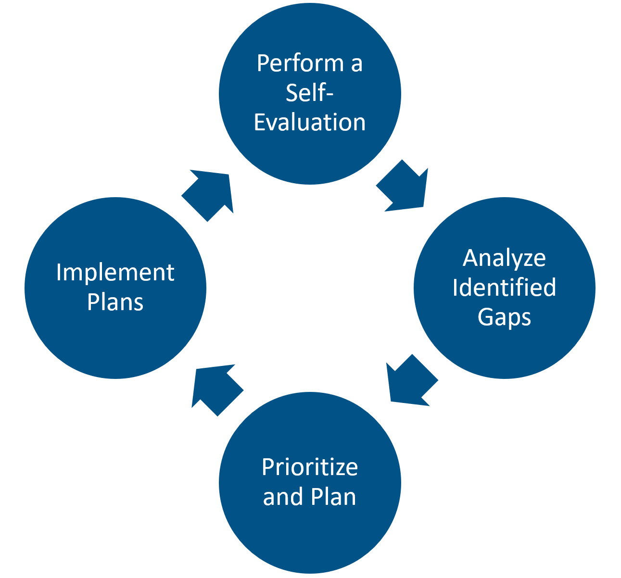
Using the Model
Perform a Self-Evaluation: determine the implementation of cybersecurity activities within the organization
Analyze Identified Gaps: determine whether the gaps are meaningful and important and should be addressed
Prioritize and Plan: prioritize the actions needed to fully implement the practices to achieve the desired capability
Implement Plan: implement the plans defined in the previous step to address the identified gaps

Slide 15
Self-Evaluation Overview

Slide 16
Self-Evaluation Roles
Number | Role | Names
1 | Sponsor
2 | Organizer
3 | Facilitator
4 | SMEs
5 | Observers
6 | Scribe
7 | Support Staff
8 | Participants
Notes:
Placeholder for listing roles involved in the Self-Evaluation

Slide 17
Defining the Scope of the Self-Evaluation
Identify the function in scope for the self-evaluation
“Function” is the part of the organization to which the C2M2 is applied
Consider the level of similarity of security management when selecting a function
Consider the systems and organizations that share interdependencies with the function
A self-evaluation for the in-scope function would include
Assets important to the delivery of the function
Assets within the function that may be leveraged to achieve a threat objective
Other potential assets within the function (e.g., data in the cloud, mobile devices)
Third-parties that have access to, control of, or custody of the function’s assets
Third-parties upon which the function depends

Slide 18
Agreed-Upon Function and Scope
Placeholder for the organization performing the self-evaluation to describe the organization’s identified function in-scope for the self-evaluation

Slide 19
Self-Evaluation Process
The facilitator will assist the group in reaching consensus on responses
Select the response that best matches the level of implementation for each practice
If consensus cannot be reached, moving on and returning later may help facilitate consensus

Slide 20
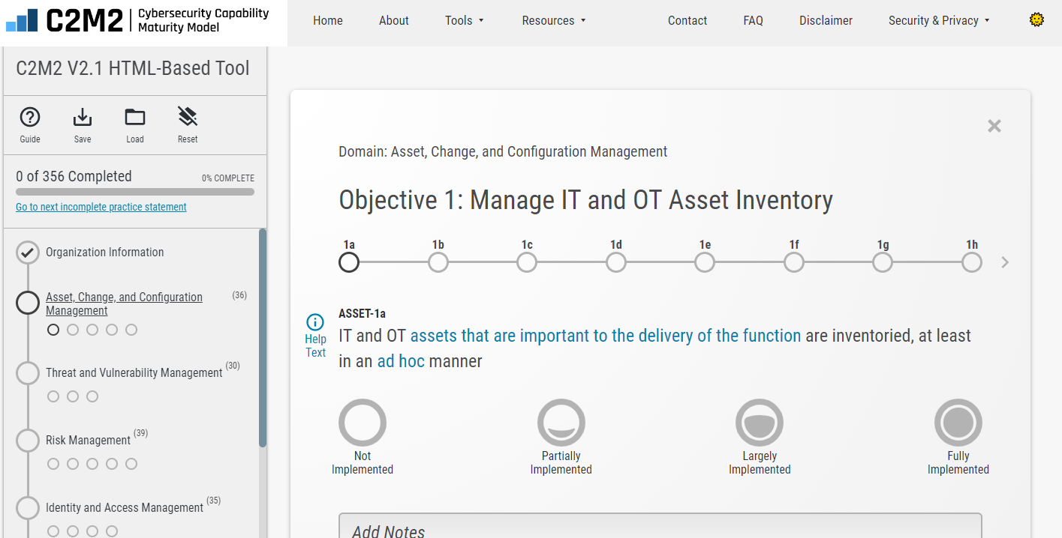
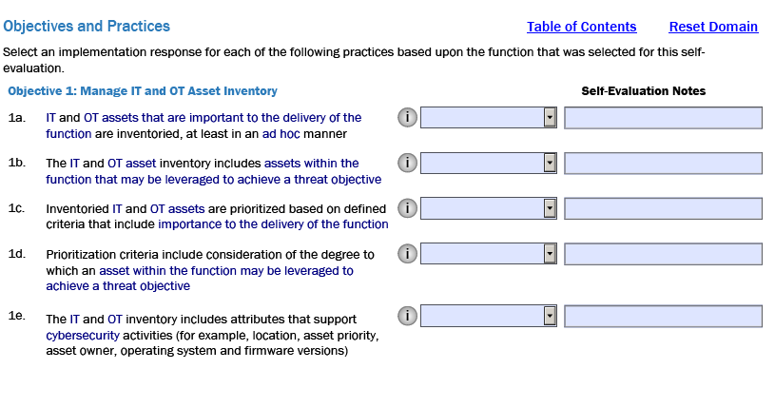
Self-Evaluation Tool
The self-evaluation tool will not create a self-evaluation report unless a response is selected for every practice
If the organization has chosen to not implement a practice, select Not Implemented
Use the notes field to capture important information (e.g., rationale for responses) that may be of use later in explaining self-evaluation results
Notes:
Select the screenshot of the chosen tool

Slide 21
Response Options
Response | Description
Fully Implemented (FI) | Complete
Largely Implemented (LI) | Complete, but with a recognized opportunity for improvement
Partially Implemented (PI) | Incomplete; there are multiple opportunities for improvement
Not Implemented (NI) | Absent; the practice is not performed by the organization

Slide 22
Selecting Responses
Consider key phrases in the practices
Examples of key phrases
“periodically and according to defined triggers”
“is established and maintained”
Use the clickable pop-up definitions of key terms or the glossary to help answer specific questions
Use the help text to help answer specific questions about practices
Responses should reflect the current state of the organization
Consider documenting in-progress or planned projects in the notes field
Consider updating your self-evaluation when in-progress or planned projects are complete or at a set period, such as every six months

Slide 23
Asset Types Included in the C2M2
Asset: something of value to the organization
IT asset: hardware and software
OT asset: hardware and software
Information asset: information essential for operating the function
Consider these three types of asset when C2M2 practices refer to “assets.”
Examples of Assets
IT Assets | OT Assets | Information Assets
Workstations Switches, routers, and firewalls Servers Virtual machines Software | Workstations Switches, routers, and firewalls Servers Virtual machines Software Programmable Logic Controllers HMI Stations RTUs Actuators Sensors | Business data Intellectual property Customer information Contracts Security logs Metadata

Slide 24
Ad Hoc Practices
By design, MIL1 practices may be implemented in an ad hoc manner and still be considered Fully Implemented.
Performance of ad hoc practices may depend on the initiative and experience of an individual or team, without much organizational guidance (e.g., policy or procedures)
The quality of the outcome may vary significantly depending on who is performing the practice and other factors such as the methods or tools used
Lessons learned may not be captured and outcomes may be difficult to repeat
Institutional knowledge is not captured in documented policy, procedures, or work instructions
The practice may not be retained over time or under times of stress
Implementation of ad hoc practices, like any other practice, may result in documented artifacts (e.g., asset inventories, a cybersecurity program strategy)

Slide 25
Practice With Dependencies
There are several practices that, depending on how they are scored, inform the logical response for certain other practices.
Practices that contain dependencies reference the related practice in parentheses within the text of the practice.
For example, THREAT 2j is dependent upon SITUATION 3g. THREAT-2j states “Threat monitoring and response activities leverage and trigger predefined states of operation (SITUATION-3g).”
If SITUATION 3g is scored as Not Implemented (i.e., the organization has not identified predefined states of operation), then THREAT-2j should not be scored as Largely Implemented or Fully Implemented.

Slide 26
Practices with Compound Statements
If some but not all activities in a practice are implemented, the response should reflect the level of implementation (i.e., it should not be considered Fully Implemented)
For example, ARCHITECTURE-1b states “A strategy for cybersecurity architecture is established and maintained in alignment with the organization’s cybersecurity program strategy (PROGRAM-1b) and enterprise architecture”
If the strategy exists but is not routinely updated, Largely Implemented should be considered instead of Fully Implemented

Slide 27
Practice Progressions
The model includes sets of related practices that form increasingly complete, comprehensive, or advanced implementations of an activity
These are called practice progressions and are noted in the help text
These practice progressions mostly start with ad hoc practices in MIL1 that serve as a foundation upon which the other practices build
When evaluating a practice in a progression, implementation of prior practices in the progression should be considered

Slide 28
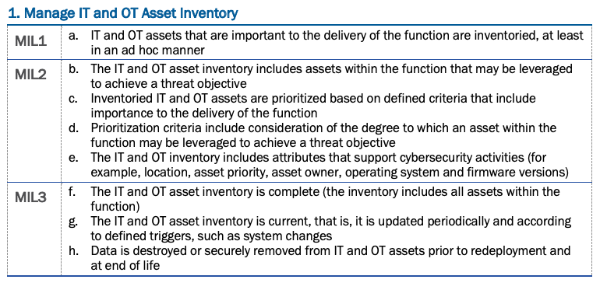
Practice Progression Example
ASSET-1a, ASSET-1b, ASSET-1f, and ASSET-1g form a progression. These practices are about the IT and OT asset inventory being created and growing in completeness and accuracy.

Slide 29
Scoring and Interpretation

Slide 30
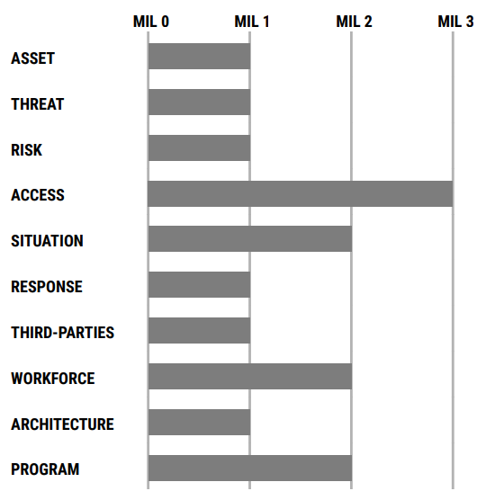
Sample MIL Achievement by Domain
A summary bar chart provides a quick indication of the MIL achieved in each domain.
In this example:
MIL3 has been achieved in ACCESS.
MIL2 has been achieved in SITUATION, WORKFORCE, and PROGRAM.
MIL1 has been achieved in all other domains.

Slide 31
Sample Summary Score MIL1
There are 3 practices at MIL1 for the SITUATION domain
MIL3
MIL2
The colors and numbers in the ring summarize implementation level of those practices; in this case, 2 practices at MIL1 are Fully Implemented and 1 is Largely Implemented
MIL1

Slide 32
Sample Summary Score MIL2
There are 16 cumulative practices at MIL2; 3 at MIL1 and 13 at MIL2
MIL3
2 practices are Fully Implemented
9 practices are Largely Implemented
5 practices are Partially Implemented
MIL2
MIL1

Slide 33
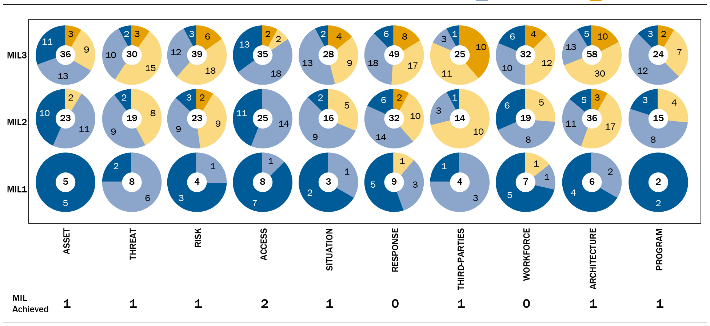
Sample Summary Score
This figure shows summarized results for every practice, grouped by domain
To achieve a MIL in a domain, all practices in that MIL and in all preceding MILs must have responses of either Fully Implemented or Largely Implemented

Slide 34
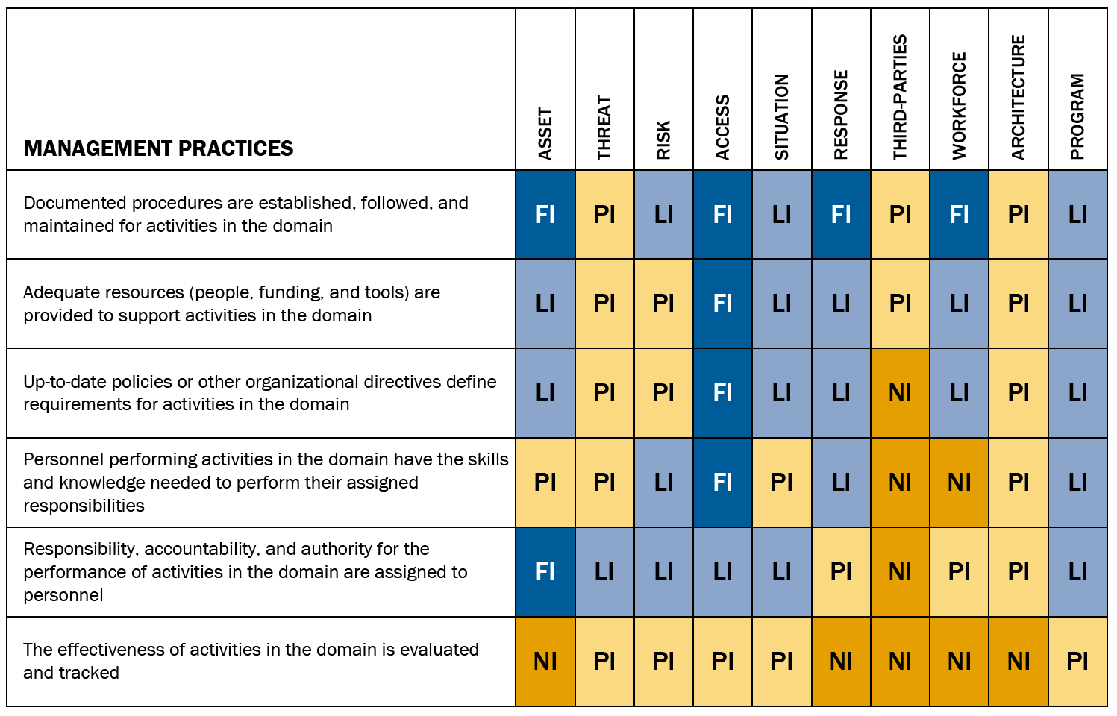
Summary of Management Activities
Management Activities focus on the extent to which cybersecurity practices are institutionalized, or ingrained, in the organization’s operations
This chart offers an overview from two perspectives:
implementation within each domain
implementation across the 10 domains

Slide 35
Questions?

Slide 36
Thank You

